Slide 1
HR-EmployeeDashboard

Slide 2
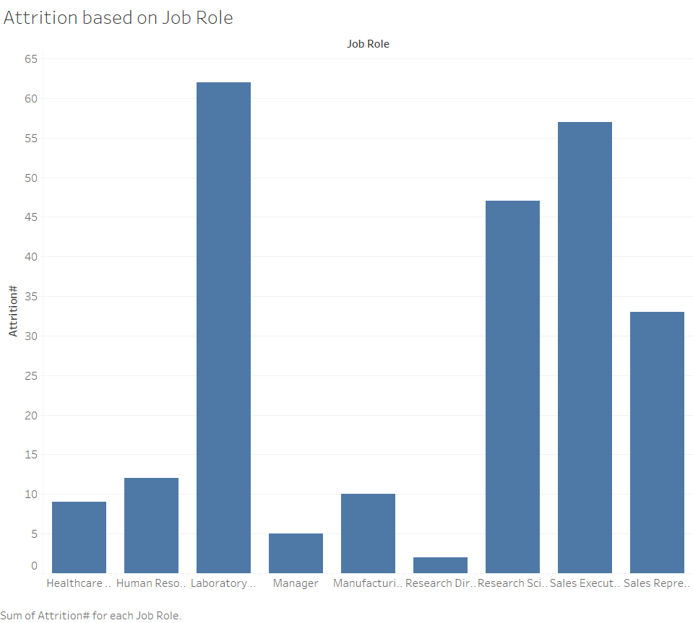
Through this chart, we can understand the
Attrition based on job role, with Laboratory
Technician having the highest attrition and
Research director having the least attrition
Rate.

Slide 3
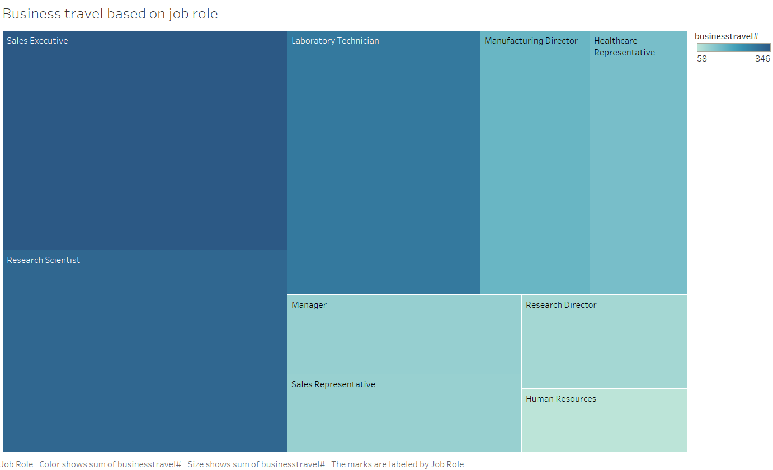
Through this data representation
We can find which job role has the
Most business travels, Sales Executive
Being the most and Human Resource
Being the least

Slide 4
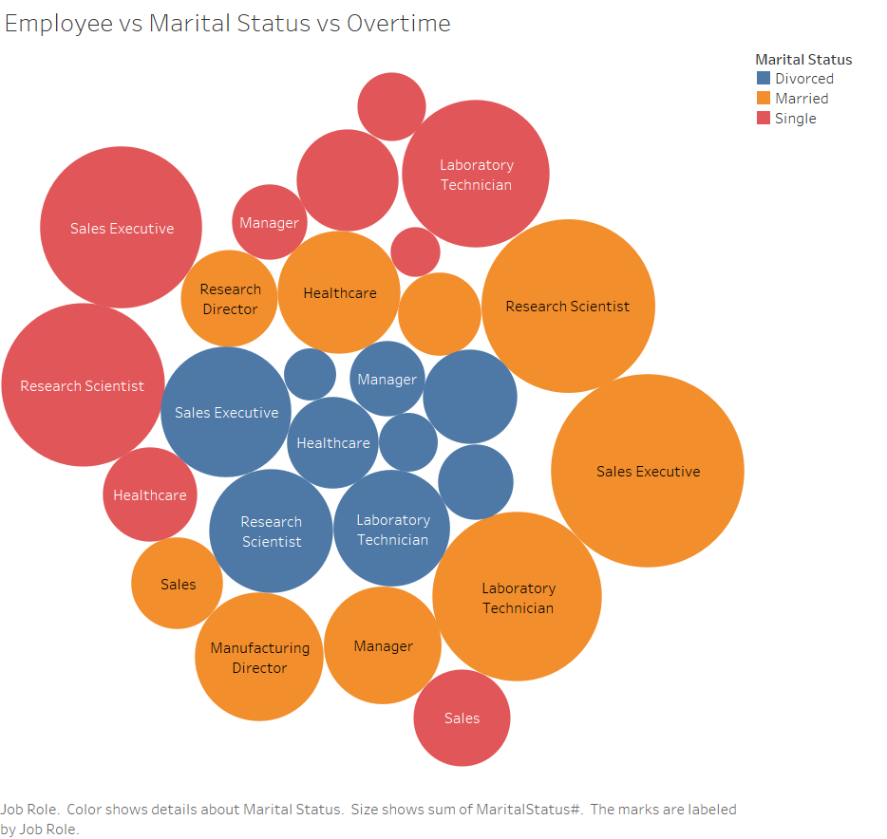
This chart shows the marital status
As well as the overtime based on job role
Which can also help in determining the work
Life balance

Slide 5
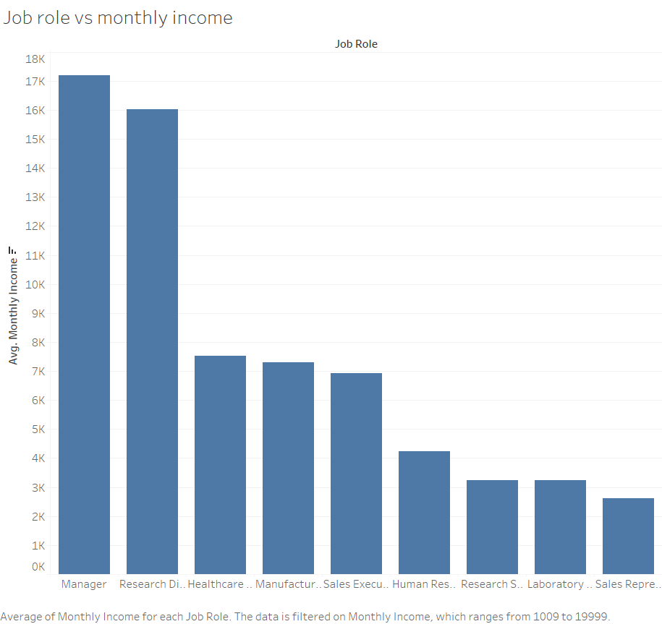
Through this data representation we can determine the average Salary based on job role.

Slide 6
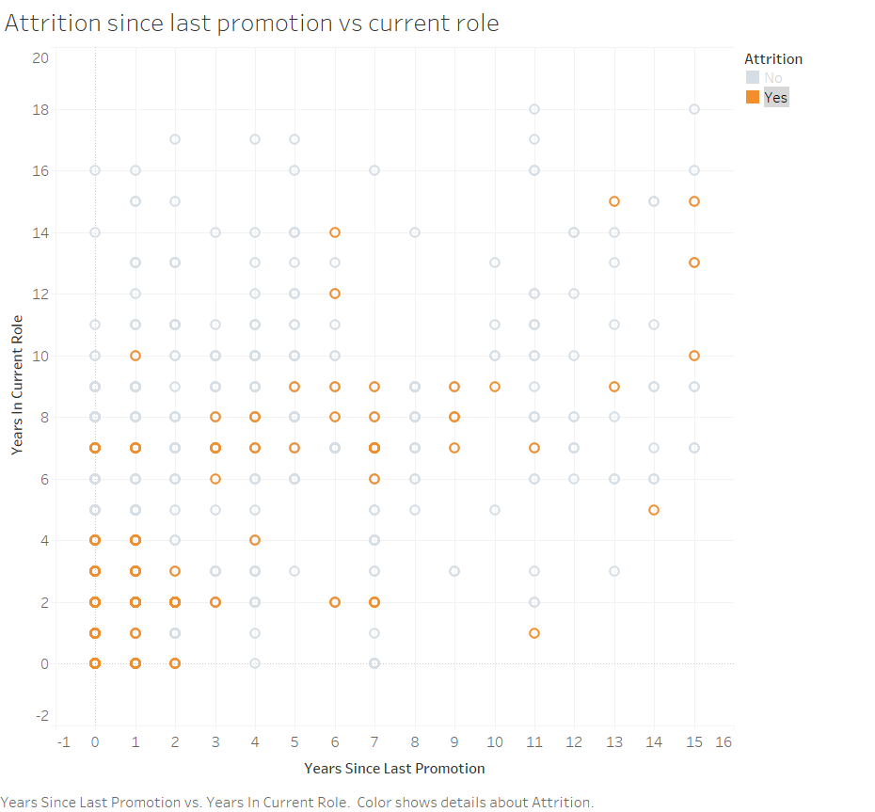
This data representation shows the attrition based on last promotion they got and for how many years they have been on the current role since their last promotion.

Slide 7
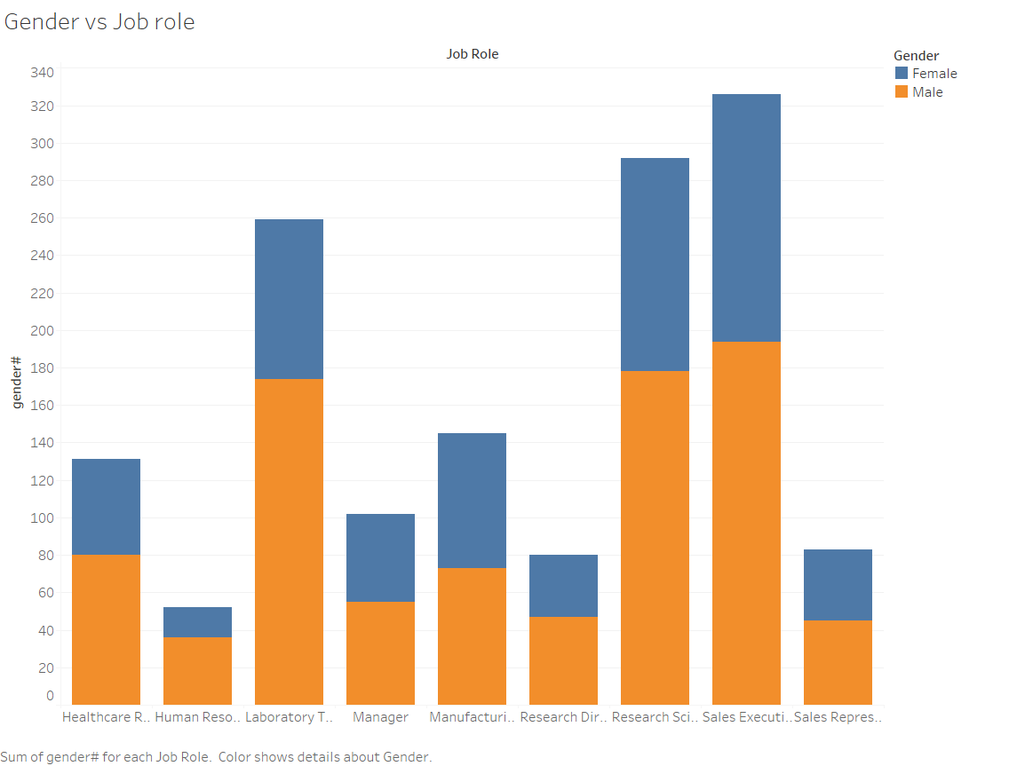
Through this data representation we can find out which
Gender has more males than females or more females
Than males.

Slide 8
For complete dashboard representation please visit the below link:
https://aman2620.github.io/Tableau-projects/

